Slide 1
Object Oriented Programming Using Java Module 5

Slide 2
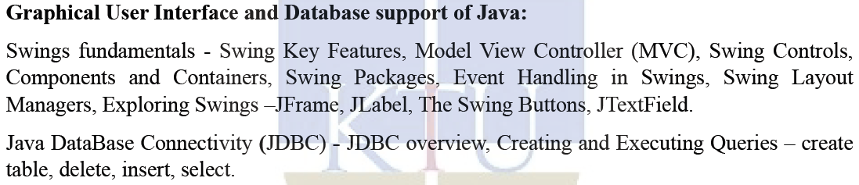
SYLLABUS – MODULE 5

Slide 3
SWING

Slide 4
SWING
Swing API is a set of extensible GUI Components - to ease the developer's life to create JAVA based GUI Applications.
It is a replacement for AWT (Abstract Window Toolkit) API, since it has almost every control corresponding to AWT controls.
Swing provides richer and easier to use user interface than does AWT.
Swing classes are defined in javax.swing package and its sub-packages.
The javax.swing package provides classes for java swing API such as JButton, JTextField, JTextArea, JRadioButton, JCheckbox, JMenu, JColorChooser etc.

Slide 5
SWING
Swing Framework contains a set of classes that provides more powerful and flexible GUI components than those of AWT.
Swing provides the look and feel of modern Java GUI.
Swing library is an official Java GUI tool kit released by Sun Microsystems.
It is used to create graphical user interface with Java.
Java Swing is a part of Java Foundation Classes (JFC) - set of GUI components which simplify the development of desktop applications.
Unlike AWT, Java Swing provides platform-independent and lightweight components.

Slide 6
FEATURES OF SWING TOOLKIT
Lightweight
Rich Controls
Highly Customizable
Pluggable Look and Feel

Slide 7
FEATURES OF SWING TOOLKIT
Lightweight :
Swing components are lightweight as they are written entirely in Java and do not depend on native Operating System's API.
Rather, they use simple drawing primitives to render themselves on the screen.
The look and the feel of the component is not controlled by the underlying operating system but by Swing itself.
Thus, they are not restricted to platform-specific appearance like, rectangular or opaque shape.
Most of the components are lightweight but not all.

Slide 8
FEATURES OF SWING TOOLKIT
Rich Controls :
Swing provides a rich set of advanced controls like Tree, TabbedPane, slider, colorpicker, and table controls.
Highly Customizable :
Swing controls can be customized in a very easy way as visual appearance is independent of internal representation.

Slide 9
FEATURES OF SWING TOOLKIT
Pluggable Look and Feel :
SWING based GUI Application look and feel can be changed at run-time, based on available values.
As the look and feel of components is controlled by Swing rather than by operating system, the feel of components can also be changed.
Thus, it is possible to "plug in" a new look and feel for any given component without affecting the rest of the code.

Slide 10
MODEL-VIEW-CONTROLLER ARCHITECTURE

Slide 11
MVC ARCHITECTURE
It is a way to organize the code.
A visual component is a composite of three distinct aspects:
The way that the component looks when rendered on the screen.
The way that the component reacts to the user.
The state information associated with the component.
By separating a component into a model, a view, and a controller, the specific implementation of each can be changed without affecting the other two.

Slide 12
SWING API ARCHITECTURE
Swing API architecture follows loosely based MVC architecture in the following manner.
Model represents component's data.
View represents visual representation of the component's data.
Controller takes the input from the user on the view and reflects the changes in Component's data.
Swing component has Model as a separate element, while the View and Controller part are clubbed in the User Interface elements.
Swing uses a modified version of MVC that combines the view and the controller into a single logical entity called the UI delegate.
Swing’s approach is called either the Model-Delegate architecture or the Separable Model architecture.

Slide 13
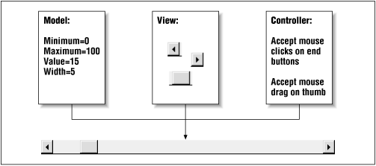

Slide 14
MVC ARCHITECTURE
The model
Corresponds to the state information associated with the component.
For example, in the case of a check box, the model contains a field that indicates if the box is checked or unchecked.
The view
Determines how the component is displayed on the screen.
The controller
Determines how the component reacts to the user.
For example, when the user clicks a check box, the controller reacts by changing the model to reflect the user’s choice (checked or unchecked). This then results in the view being updated.

Slide 15

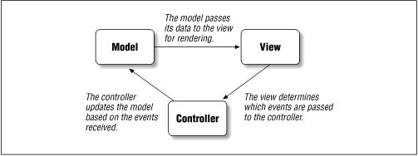

Slide 16
